Slide 1
Hurtownie Danych
SSIS Podstawy cz.2

Slide 2
Data Flow

Slide 3
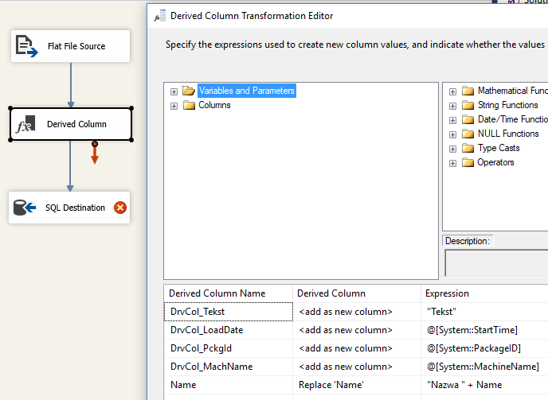
Derived Columns
The Derived Column transformation creates new column values by applying expressions to transformation input columns. An expression can contain any combination of variables, functions, operators, and columns from the transformation input. The result can be added as a new column or inserted into an existing column as a replacement value. The Derived Column transformation can define multiple derived columns, and any variable or input columns can appear in multiple expressions.
Concatenate data from different columns into a derived column.
Extract characters from string data by using functions such as SUBSTRING, and then store the result in a derived column.
Apply mathematical functions to numeric data and store the result in a derived column.
Create expressions that compare input columns and variables.
Extract parts of a datetime value.
Convert date strings to a specific format using an expression.

Slide 4
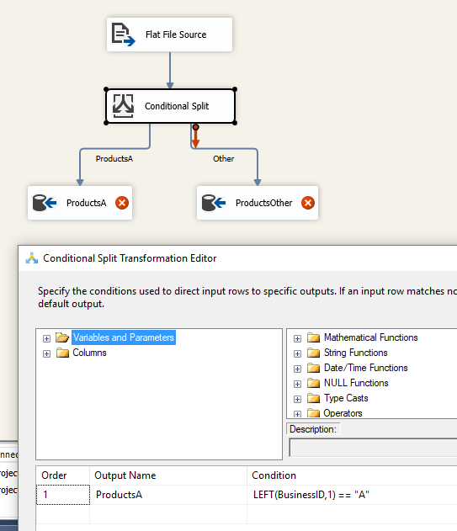
Conditional Split
The Conditional Split transformation can route data rows to different outputs depending on the content of the data. The implementation of the Conditional Split transformation is similar to a CASE decision structure in a programming language. The transformation evaluates expressions, and based on the results, directs the data row to the specified output. This transformation also provides a default output, so that if a row matches no expression it is directed to the default output.
https://docs.microsoft.com/en-us/sql/integration-services/data-flow/transformations/conditional-split-transformation

Slide 5
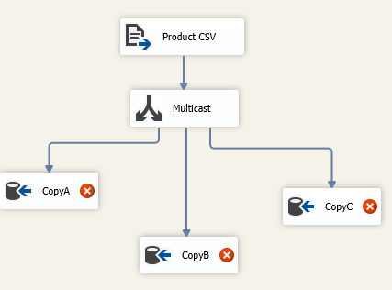
Multicast
The Multicast transformation distributes its input to one or more outputs. This transformation is similar to the Conditional Split transformation. Both transformations direct an input to multiple outputs. The difference between the two is that the Multicast transformation directs every row to every output, and the Conditional Split directs a row to a single output. For more information, see Conditional Split Transformation.
You configure the Multicast transformation by adding outputs.
Using the Multicast transformation, a package can create logical copies of data. This capability is useful when the package needs to apply multiple sets of transformations to the same data. For example, one copy of the data is aggregated and only the summary information is loaded into its destination, while another copy of the data is extended with lookup values and derived columns before it is loaded into its destination.
https://docs.microsoft.com/en-us/sql/integration-services/data-flow/transformations/multicast-transformation

Slide 6
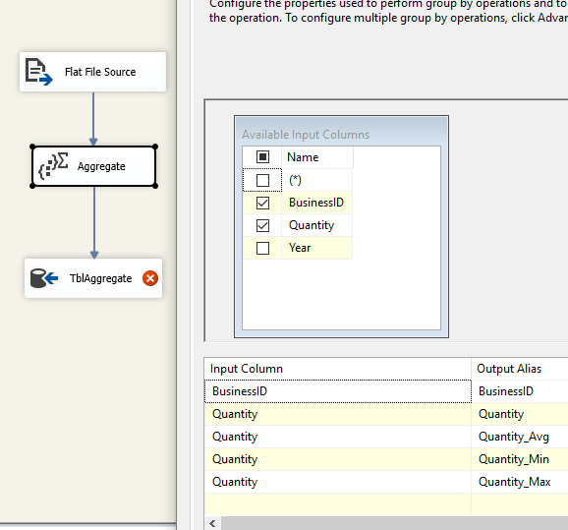
Aggregate
The Aggregate transformation applies aggregate functions, such as Average, to column values and copies the results to the transformation output. Besides aggregate functions, the transformation provides the GROUP BY clause, which you can use to specify groups to aggregate across.
https://docs.microsoft.com/en-us/sql/integration-services/data-flow/transformations/aggregate-transformation

Slide 7
Lookup
The Lookup transformation performs lookups by joining data in input columns with columns in a reference dataset. You use the lookup to access additional information in a related table that is based on values in common columns.
The reference dataset can be a cache file, an existing table or view, a new table, or the result of an SQL query.
If there is no matching entry in the reference dataset, no join occurs. By default, the Lookup transformation treats rows without matching entries as errors.
If there are multiple matches in the reference table, the Lookup transformation returns only the first match returned by the lookup query. If multiple matches are found, the Lookup transformation generates an error or warning only when the transformation has been configured to load all the reference dataset into the cache.
The join can be a composite join, which means that you can join multiple columns in the transformation input to columns in the reference dataset.

Slide 8
Date Conversion
The Data Conversion transformation converts the data in an input column to a different data type and then copies it to a new output column. For example, a package can extract data from multiple sources, and then use this transformation to convert columns to the data type required by the destination data store. You can apply multiple conversions to a single input column.
Change the data type.
Set the column length of string data and the precision and scale on numeric data.
Specify a code page (*).
https://docs.microsoft.com/en-us/sql/integration-services/data-flow/transformations/data-conversion-transformation
(*) In computing, a code page is a table of values that describes the character set used for encoding a particular set of characters, usually combined with a number of control characters.
https://en.wikipedia.org/wiki/Code_page

Slide 9
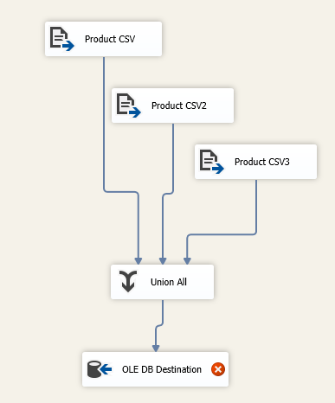
Union All
The Union All transformation combines multiple inputs into one output. For example, the outputs from five different Flat File sources can be inputs to the Union All transformation and combined into one output.
The transformation inputs are added to the transformation output one after the other; no reordering of rows occurs. If the package requires a sorted output, you should use the Merge transformation instead of the Union All transformation.
https://msdn.microsoft.com/pl-pl/library/ms141020(v=sql.110).aspx

Slide 10
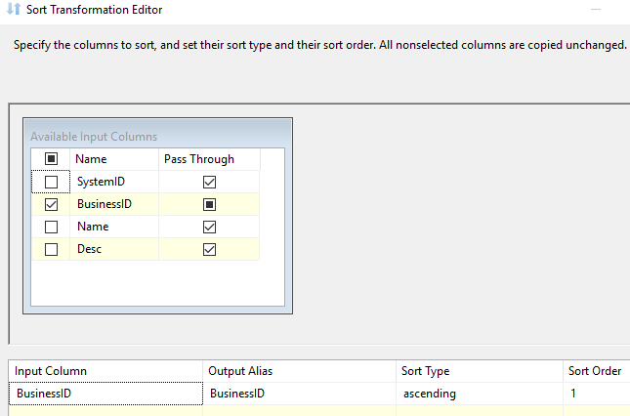
Sort
The Sort transformation sorts input data in ascending or descending order and copies the sorted data to the transformation output. You can apply multiple sorts to an input; each sort is identified by a numeral that determines the sort order. The column with the lowest number is sorted first, the sort column with the second lowest number is sorted next, and so on.
https://docs.microsoft.com/en-us/sql/integration-services/data-flow/transformations/sort-transformation

Slide 11
Merge Join
The Merge Join transformation provides an output that is generated by joining two sorted datasets using a FULL, LEFT, or INNER join. For example, you can use a LEFT join to join a table that includes product information with a table that lists the country/region in which a product was manufactured. The result is a table that lists all products and their country/region of origin.
You can configure the Merge Join transformation in the following ways:
Specify the join is a FULL, LEFT, or INNER join.
Specify the columns the join uses.
Specify whether the transformation handles null values as equal to other nulls.
https://docs.microsoft.com/en-us/sql/integration-services/data-flow/transformations/merge-join-transformation

Slide 12
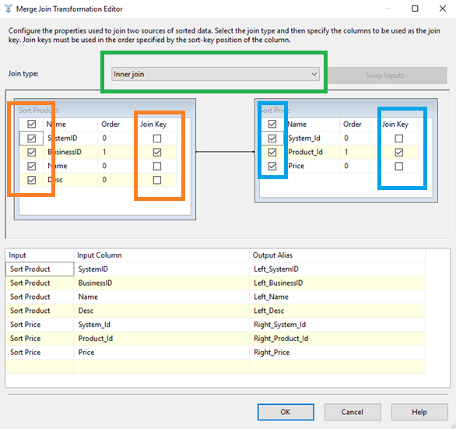
Merge Join

